Slide 1
Neuropixel
Extracellular recordings
Lucas Guesry, Madeline Desautel

Slide 2
Extracellular recording
records outside of the neuron
single or multi units
in vivo or in vitro
high temporal resolution

Slide 3
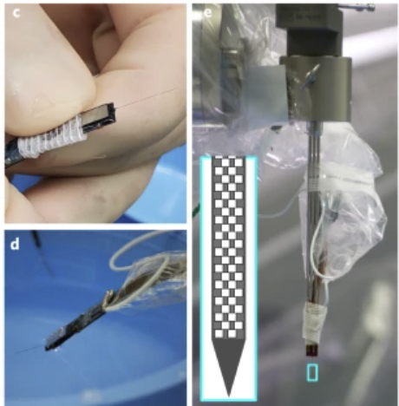
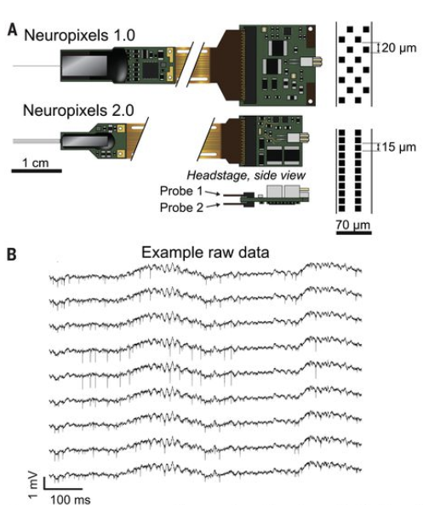
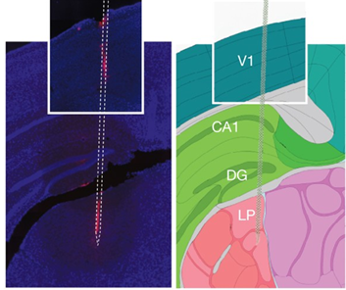
Neuropixel
components:
-silicon shank(s) for implantation
-base with ADCs and multiplexers
-headstage for precise voltage supply and interfacing
-external computer for analyses

Slide 4
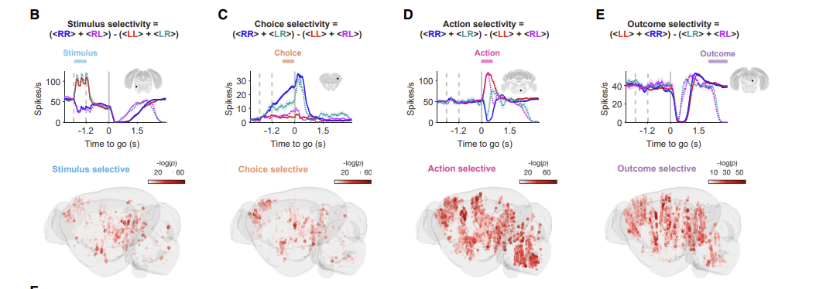
Neuropixel
Neurons from different areas fire action potentials depending on the current task (processing the stimulus, choosing a task to perform, moving to perform the task, processing the outcome)

Slide 5
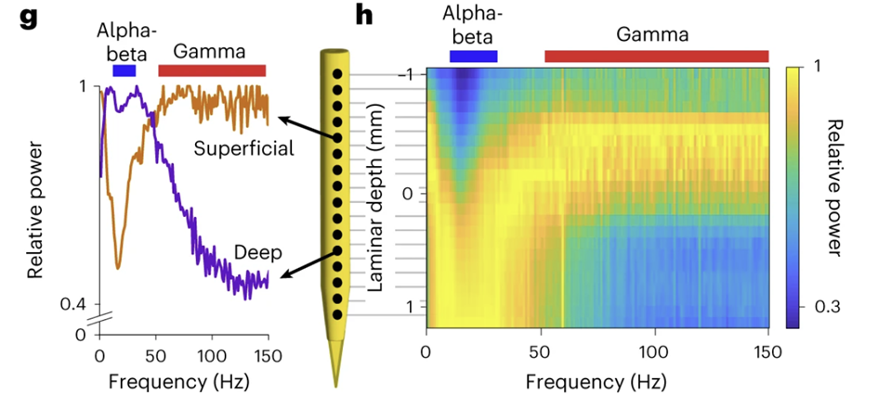
Neuropixel
right: depth-frequency map, spectrolaminar motifs appear
-> more alpha-beta oscillations in deeper layers
-> more gamma oscillations in superficial layers
layers interact through these oscillations

Slide 6
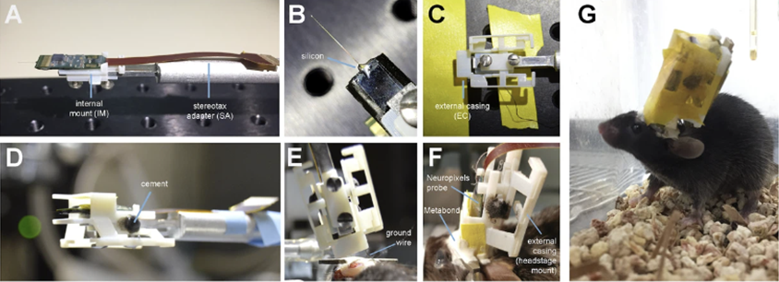
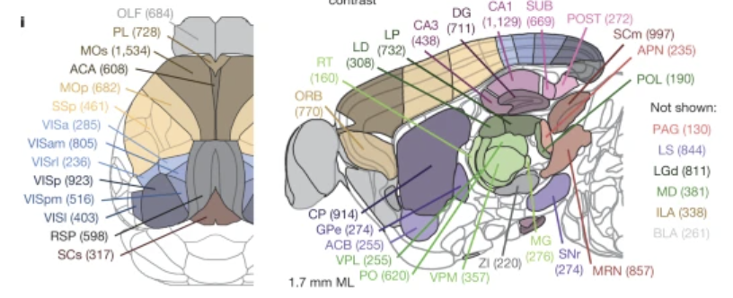
Usage on rodents
subjects are head-fixed for short experiments (to study sensory processing, basic behavior)
subjects are free to move for weeks-long experiments (to study brain plasticity during learning, development, exploring)
Steinmetz et al. (2019): implanted 5 probes in a mouse to study vision, choice and action
Neuropixel-Nexus – Juavinett et al., 2019
all brain regions recorded by steinmetz et al.

Slide 7
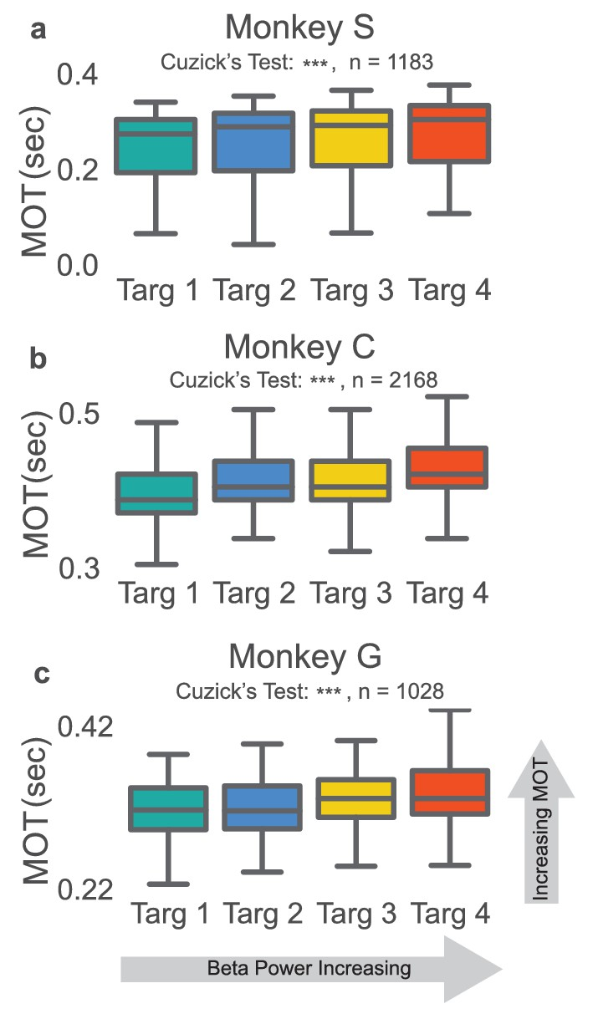
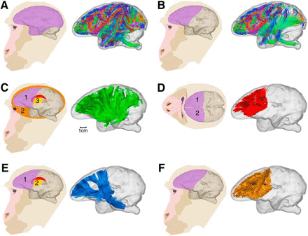
Usage on primates
primates have a brain structure similar to humans
study of complex behaviors and decision making
right: more beta oscillations leads to more time taken to start movement

Slide 8
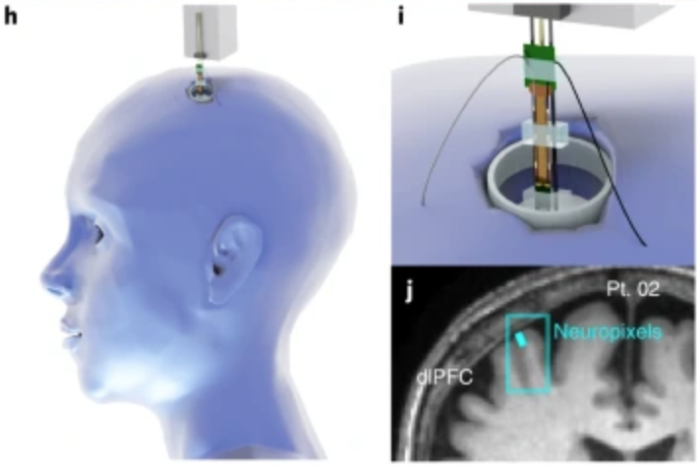
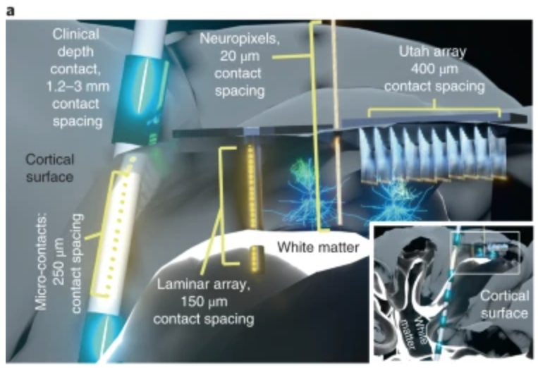
Usage on humans - technical challenge
adapt hardware for humans
surgical rooms
electronic disturbance
anaesthetics disturbance

Slide 9
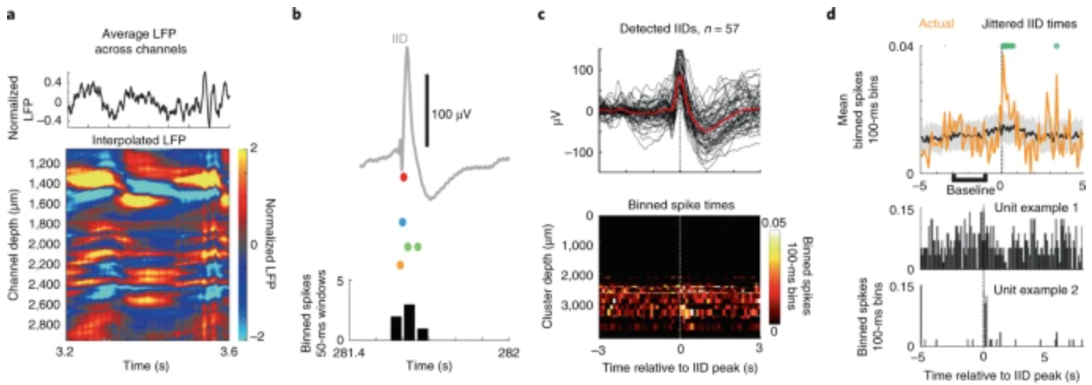
Usage on humans - ethical concerns
concerns for the patients
resection for epilepsy or tumors
risk of brain damage
privacy concerns

Slide 10
Usage on humans - future direction
onboard memory
record natural behaviour
better wireless technology
combining with other methods

Slide 11
Conclusion
long term multi-unit recording
low disruption of behavior
high resolution
doubling recording size every 7 years

Slide 12
References:
Slide 3 : https://www.nature.com/articles/s41593-021-00997-0, https://www.nature.com/articles/nature24636#Fig2, https://www.science.org/doi/10.1126/science.abf4588
Slide 4 : https://www.cell.com/cell/pdf/S0092-8674(23)01445-9.pdf
Slide 5 : https://www.nature.com/articles/s41593-023-01554-7
Slide 6 : https://elifesciences.org/articles/47188#:~:text=linear%20recording%20shank%20can%20record,have%20also%20been%20developed%20to, https://www.nature.com/articles/s41586-019-1787-x/figures/1
Slide 7 : https://www.jneurosci.org/content/40/10/2094/tab-figures-data, https://elifesciences.org/articles/24573
Silde 8 and 9 : https://www.nature.com/articles/s41593-021-00997-0

